Slide 1
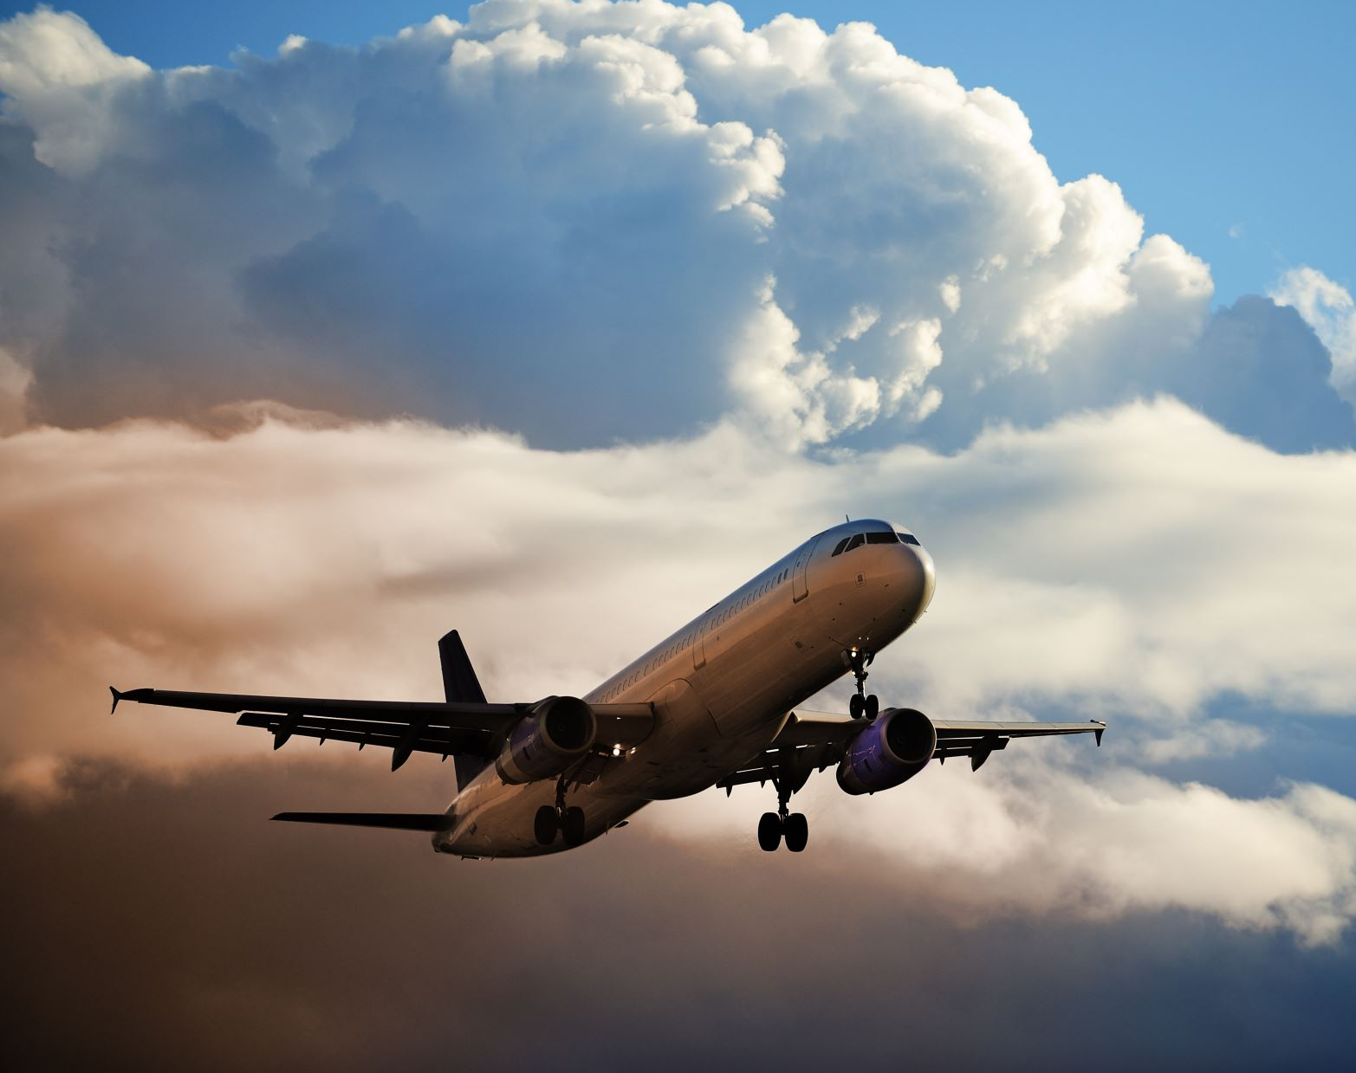
Understanding Airline Customer Satisfaction?
-Elijah Belay

Slide 2
Background information
My name is Elijah Belay. I am a Data science Student. I am also a Student Pilot! I have had a huge passion for aviation and information! I’m 17 and I just love travel and adventure. I grew up multicultural so having to learn about how people interact in many different settings was my life! One of my dreams is to fly Boeing 747’s across the world or just little floats planes in Alaska, either would work for me!

Slide 3
Data Information
Dataset with 130K rows from Kaggle
Satisfaction survey from an unknown US airline
10 Different Independent variables such as the passenger’s ages, gender, etc.
15 dependent variables as in cleanliness, On-Board service, and overall satisfaction amongst others.
There are three classes provided, but the difference between economy and economy plus were minimal so they are grouped together as economy
Note: this data set has no verifiable source, but since this is an academic exercise, I decided to utilize it

Slide 4
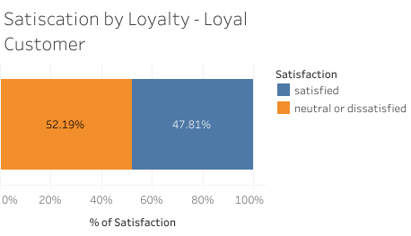
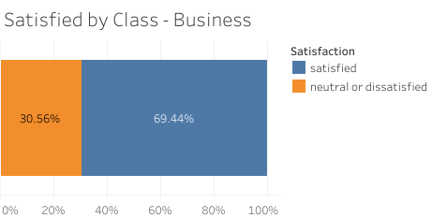
Who is Satisfied?
Graphs Shows
Almost 3/4 of Business class is satisfied
Around half of customers that are loyal to an airline are Satisfied

Slide 5
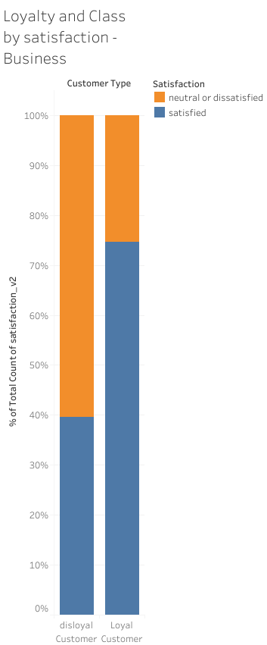
Connections Between Business and Loyalty
There is a big connection in between the satisfaction of customers in Business class and their Loyalty to the Airline
Loyal customer who fly in Business Class are usually traveling for Business reasons.
Loyal customers know what to expect, especially ones that travel frequently for business

Slide 6
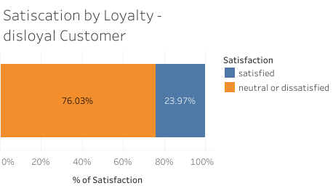
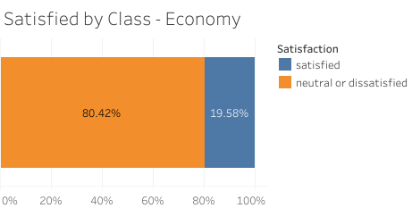
Who Isn’t?
This graph shows that by a large majority economy class passengers are neutral or dissatisfied
Disloyal Customers are almost as dissatisfied as economy passengers

Slide 7
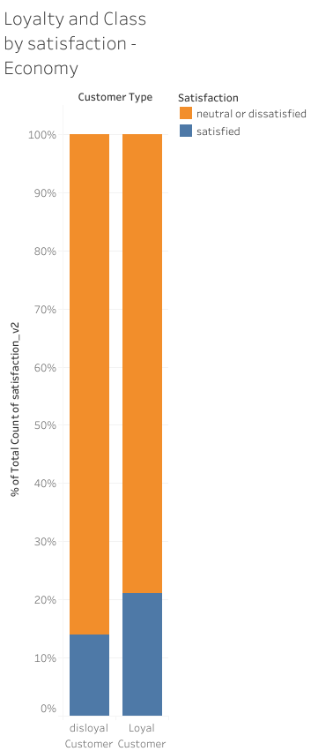
Connections between Disloyalty and Economy
Just a quick glance corroborating the lack of satisfaction in Economy class passengers
Disloyal has a lower satisfaction by around 5%, which is not as much as a difference as there is in Business class
In Economy loyalty doesn’t have a big difference in satisfaction

Slide 8
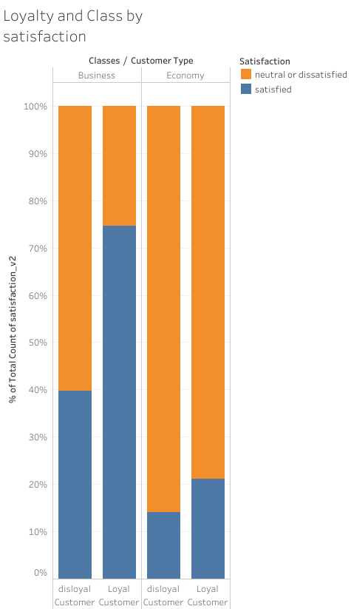
Comparing All Four
This shows that in general Passengers in Business have more Satisfactions
Also shows loyal customer are more satisfied, especially in Business where they are almost twice as satisfied than their disloyal counterparts, and the most satisfaction overall
Disloyal customers in Economy are the least satisfied
This is most likely because disloyal customers probably have to

Slide 9
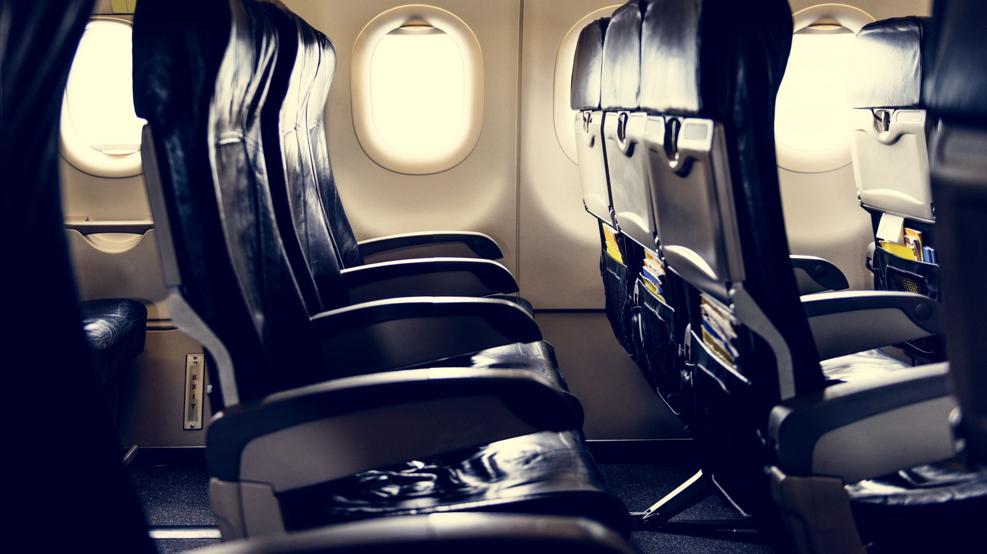
Why are Economy passengers not satisfied?

Slide 10
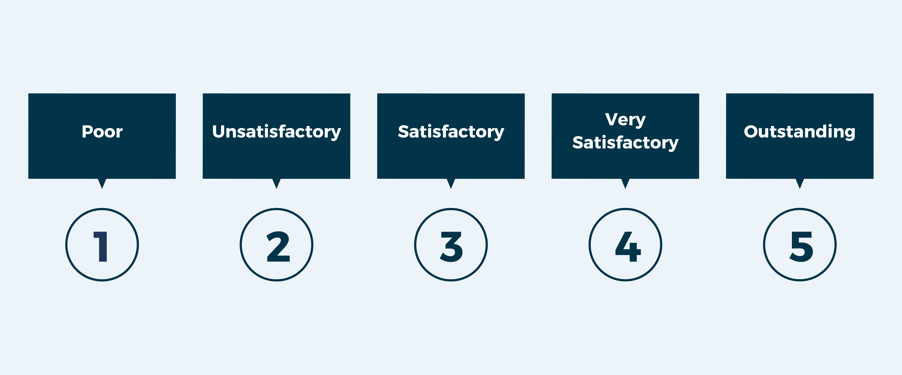
They aren’t getting Good Service!

Slide 11
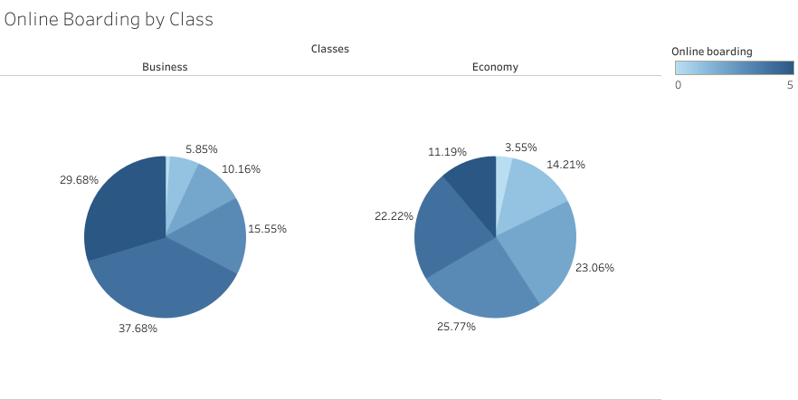
Impact of Class on Online Boarding/Check In Rating
Online boarding is the online check in passengers can do to help get them ready before they get to the airport
There is a clear discrepancy in the satisfaction between classes for these topics
Business class has around twice the amount of 4s and 5s as Economy

Slide 12
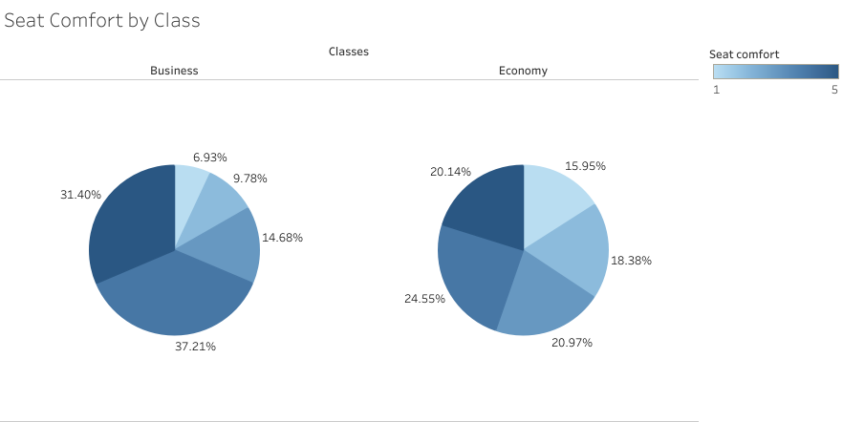
Impact of Class on Seat Comfort Ratings
Seat comfort
This service is just general enjoyability of the seat not leg room, just the comfortability of it
Business has a much large frequency of 4 and 5 as compared to others
Economy had a very even distribution
Economy still over vastly less 4 and 5 ratings as compared to Business

Slide 13
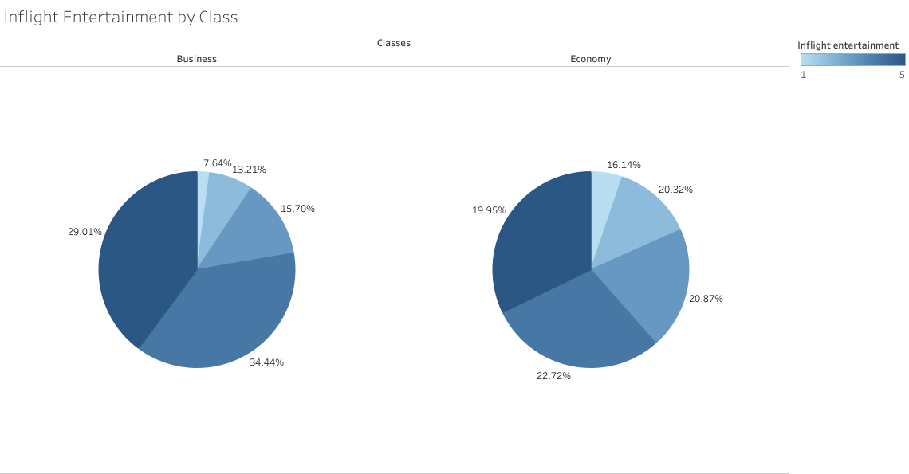
Impact of Class on Inflight Entertainment Rating
Inflight Entertainment
This service covers what the airline provided as a way for Entertainment enroute
The distribution of different levels of satisfaction is a very similar in both classes
There is a visible difference with business class having more 4 and 5 ratings.

Slide 14
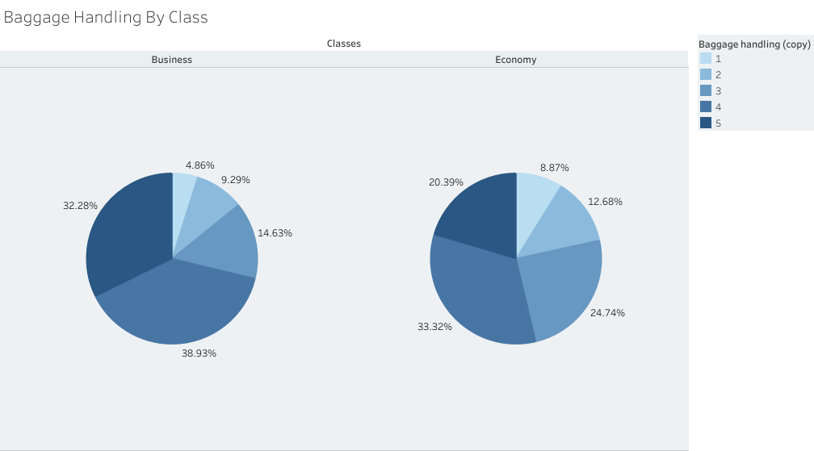
Impact of Class on Baggage Handling Rating
Baggage Handling
There is not a lot of clarity on this service, whether it’s the actual time it took for customers to receive baggage or how the bag itself was treated
There is, which matches our theme, a much larger amount of 5 in Business
Something that is different is that the amount of 4 ratings are equal
Notes:
Notes: rating 4 similar

Slide 15
Well, How About Loyalty?!!

Slide 16
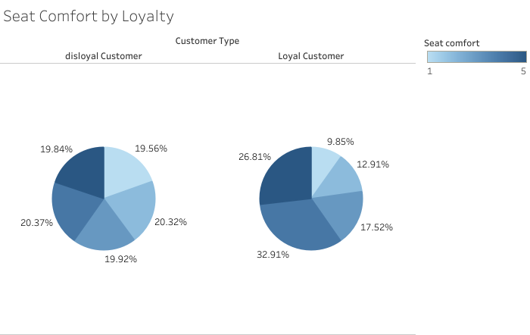
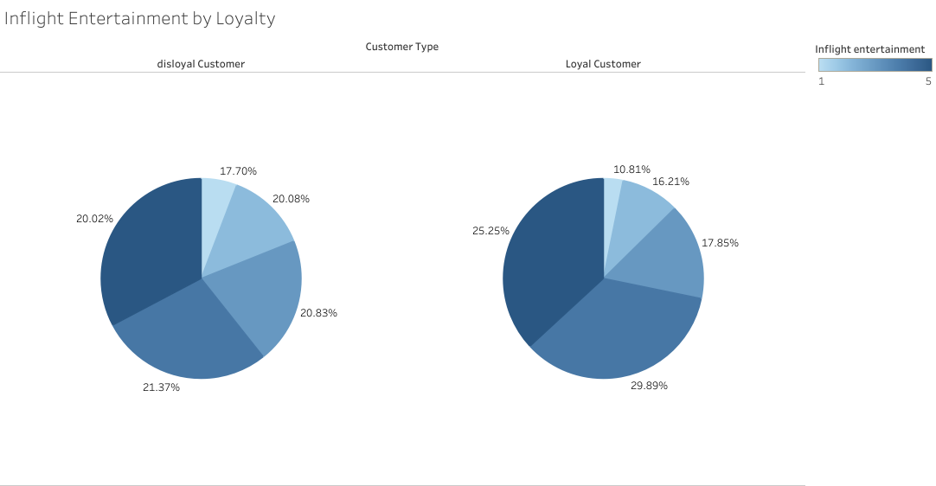
Impact of Loyalty in Satisfaction
There is not a major difference in satisfaction considering if the customer filling out the survey was loyal to the airline or not.
There are slight increases in in higher rating for each service for loyal customers
Most likely because Loyal customers know what to expect

Slide 17
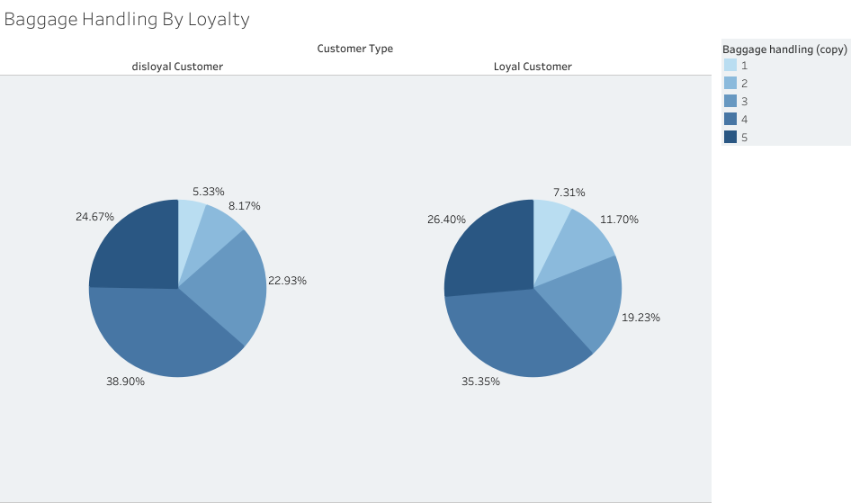
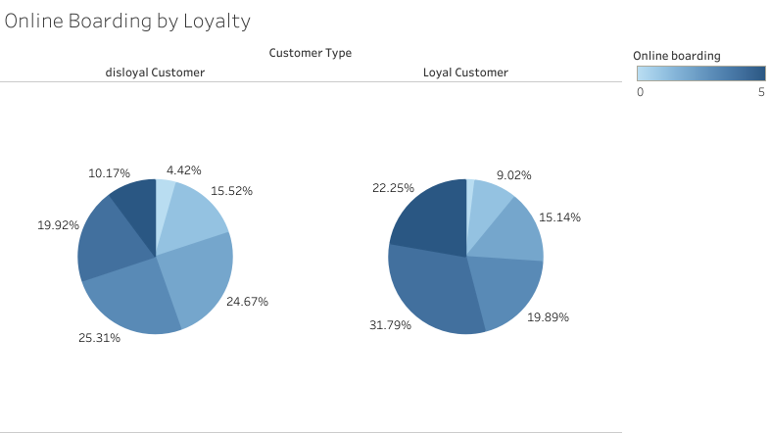
Loyalty Satisfaction Cont.
It can also be seen that some of the loyalty pie graphs mimic the class graphs
This Shows that the amount of satisfaction in loyal or disloyal customers also corresponds with the satisfaction in both Business and Economy classes

Slide 18
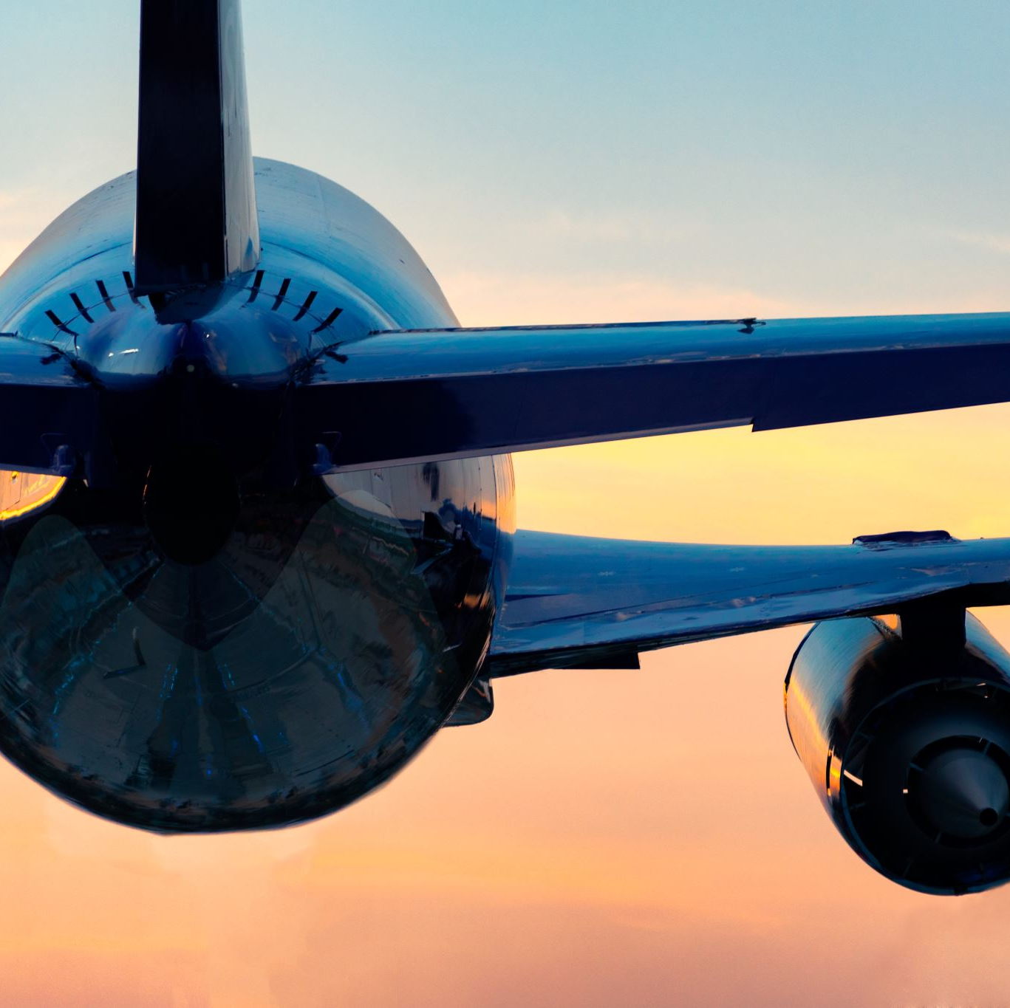
Is there any other factors?
There is one more major factor in the satisfaction of airline customers is the reason for their travel, whether they are traveling for business or personal reasons

Slide 19
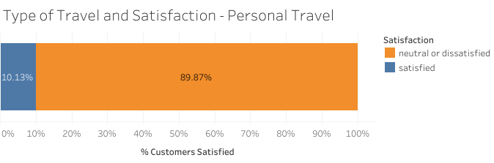
Personal Travel
Customers traveling for personal reason are one of the most unsatisfied groups paralleling disloyal customers

Slide 20
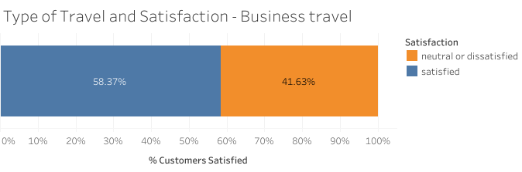
Business Travelers
Business travelers one of the most satisfied groups right behind business class
Which correlates because most business class customers are also flying for business

Slide 21
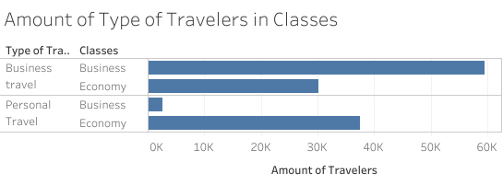
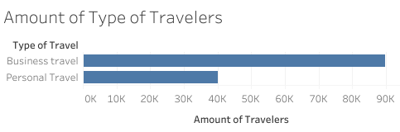
Why are customers on personal trips mostly unsatisfied?
Its because they don’t travel that much
In this survey there is over twice the amount of business travelers as there is personal travelers
Business travelers fly more, meaning they have realistic expectations of what they are going to get on their flights
Business Class passengers also dominate business class as customers

Slide 22
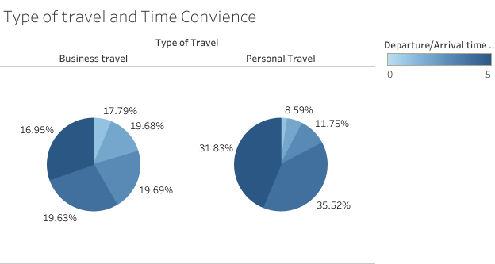
This is not always the case
Personal travelers have a large majority of 4 and 5 rating
This shows that here are cases, as shown in this graph, that personal travelers are more satisfied by a service
Business Travelers were still most satisfied

Slide 23
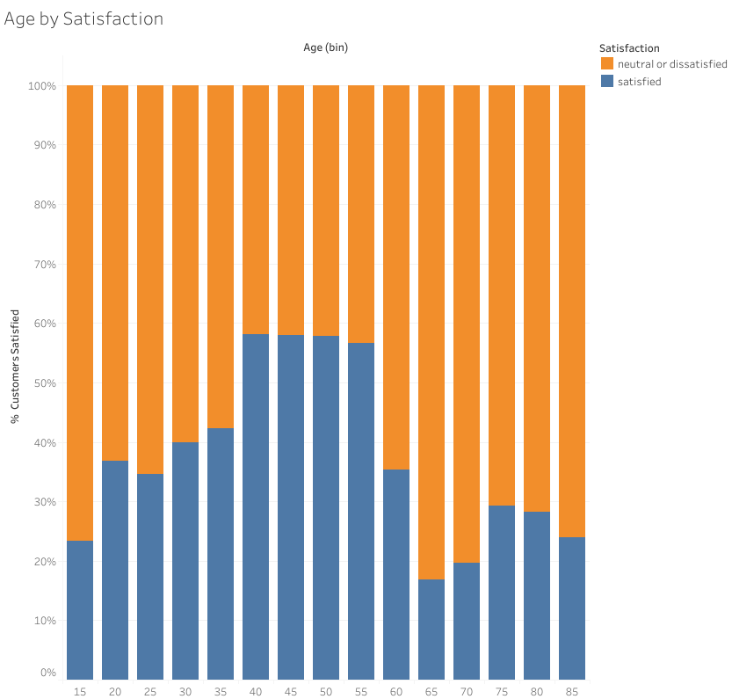
That must be all the factors, right?!!
There was one other factor that had somewhat of an affect on satisfaction and that was age
Customers age 30-59 were the most satisfied
The most unsatisfied group being people above the age of 60
Notes:
This is most likely due to these middle-aged people being mostly business travelers along with there years of traveling given them good expectations

Slide 24

What can be done?
Target Economy Class
Online Boarding: better online application
Seat Comfort: Improved seats, offer pillows
Cleanliness: revise cleaning protocols
Expectations: realistic ads
Notes:
With improvements of economy, like the examples given above, there should be an increase in satisfaction across the board

Slide 25

Reality – Expectation = Satisfaction

Slide 26
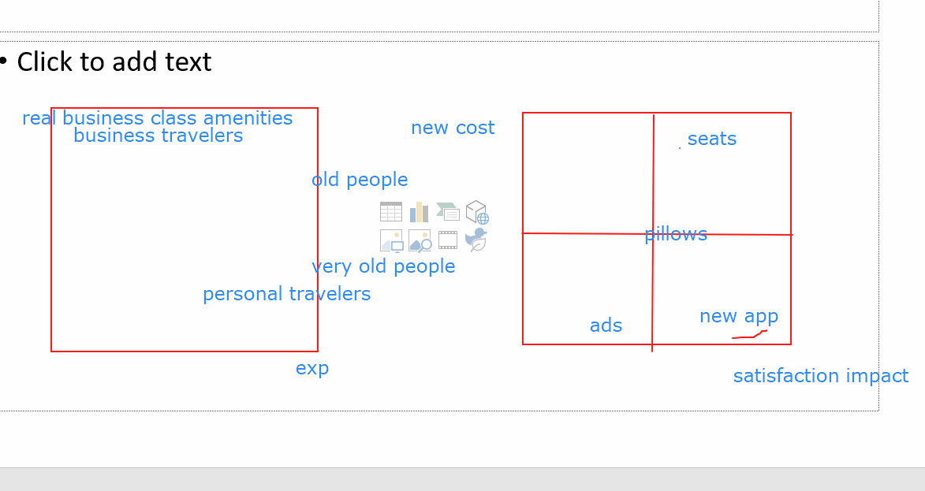

Slide 27
Summary
Expectation
Satisfaction
Reality
Notes:
Business travelers are largely more satisfied than people traveling for personal reasons
Loyal customers are more satisfied than disloyal customers
Customers in Business class are also largely more satisfied that customers in Economy
Customers aged 30-59 are the more satisfied than all other ages
Amongst the factors mentioned above the main factor for satisfaction is Class
There is a pattern in the survey that supports Economy class passengers having less satisfaction with services provided.

Slide 28
Conclusions
Economy class passengers are the least satisfied not only in certain services but also overall
To see an increase in satisfaction Economy would be the class to target because it has the most room to grow

Slide 29

Questions?

